Slide 1
Natural language processing and IBM Watson

Slide 2
Unit objectives
List the NLP Watson services.
List the Watson services that perform information extraction.
Describe the capabilities of the IBM Watson Natural Language Understanding.
Describe the capabilities of IBM Watson Discovery.

Slide 3
Topics
Watson NLP services
Watson Natural Language Understanding
Watson Discovery

Slide 4
Watson NLP services

Slide 5
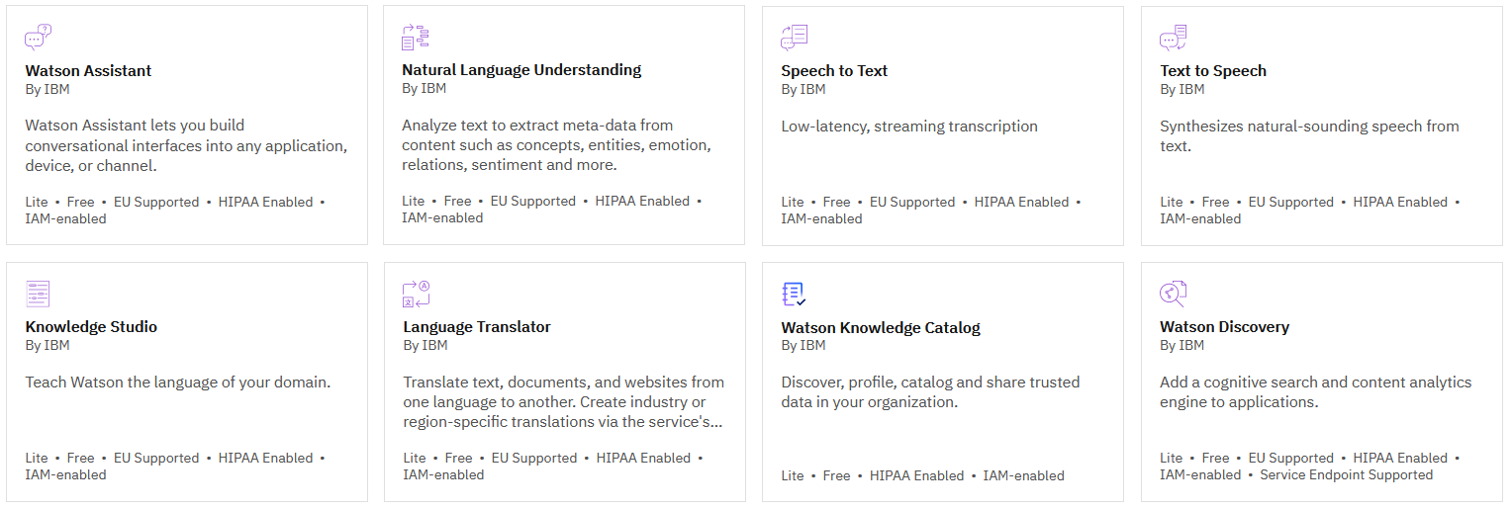
Watson NLP services
Notes:
Many Watson services have NLP at their core. The slide shows all the Watson NLP services on IBM Cloud.
The remainder of this presentation focuses on two Watson NLP services:
Natural Language Understanding
Watson Discovery
Other presentations in this course cover Watson Assistant and Knowledge Studio in detail.

Slide 6
Information extraction by using Watson services
Watson NLP services that extract information from unstructured text:
Watson Natural Language Understanding
Watson Discovery
Notes:
The Natural Language Understanding and Watson Discovery services are based on natural language processing (NLP) technology to extract information from unstructured text. These services can be used without training by the user because they include a built-in public model. They are pre-trained on a public training data set and ready to use immediately. However, to improve the accuracy of the service for a given domain, Natural Language Understanding and Discovery should also be trained.

Slide 7
Watson Natural Language Understanding

Slide 8
Watson Natural Language Understanding
NLU extracts meaning from unstructured data.
NLU processes input provided as text, HTML, or a public URL.
NLU analyzes the input text and provides an output that includes a set of text analytics features:
NLU can be extended with custom models for supported feature and language combinations.
Watson Knowledge Studio can be used to create a custom model for NLU to detect custom entities and relations that are unique to your domain.
(*) Tone analysis is done by using a pre-built classifications model.
Extraction
Entities
Classification or analysis
Sentiment
Linguistics
Semantic roles
Keywords
Concepts
Relations
Emotion
Categories
Syntax
Tone (*)
Notes:
Watson Natural Language Understanding (NLU) includes a set of text analytics features that you can use to extract meaning from unstructured data. NLU accepts user input and provides an output that includes entities and relationships that are found in the text. NLU can also perform sentiment analysis of the input text.
Input can be in the form of text, raw HTML, or a public URL. The service cleans HTML content before analysis by default so the results can ignore most advertisements and other unwanted content.
NLU can be extended with custom models for supported feature and language combinations.
You can create custom models by using Watson Knowledge Studio to detect custom entities and relations in NLU that are unique to your domain.
┌ Note ─────────────────
Tone analysis is done by using a pre-built classifications model. See next slide for more information.
└────────────────────
Reference:
Natural Language Understanding
https://cloud.ibm.com/apidocs/natural-language-understanding#introduction
Watson Natural Language Understanding – Details
https://www.ibm.com/uk-en/cloud/watson-natural-language-understanding/details
Overview - Customizing models
https://cloud.ibm.com/docs/natural-language-understanding?topic=natural-language-understanding-customizing

Slide 9
Watson Natural Language Understanding – Tone analytics
With the Natural Language Understanding service, you can analyze and detect tone by using a language-specific classifications model ID in your API request.
Tone analysis is done by using a pre-built classifications model, which provides an easy way to detect language tones in written text. It detects seven tones: sad, frustrated, satisfied, excited, polite, impolite, and sympathetic.
Example Request
Example Response
{
"language": "en",
"text": "This is example text in English.",
"features": {
"classifications": {
"model": "tone-classifications-en-v1"
}
}
}
{
"usage": {
"text_units": 1,
"text_characters": 60,
"features": 1
},
"language": "en",
"classifications": [
(cont.)
{
"confidence": 0.564849,
"class_name": "excited"
},
{
"confidence": 0.355816,
"class_name": "satisfied"
.........
Notes:
Tone analysis is done by using a pre-built classifications model, which provides an easy way to detect language tones in written text. It detects seven tones: sad, frustrated, satisfied, excited, polite, impolite, and sympathetic.
To detect tone, use the language-specific classifications model ID in your API request.
The language-specific tone model ID is formatted as tone-classifications-xx-v1, where xx is a two-character language code.
Tone analytics is currently available for English and French languages only, as indicated in the Language support topic at https://cloud.ibm.com/docs/natural-language-understanding?topic=natural-language-understanding-language-support.
References:
Understanding tone analytics
https://cloud.ibm.com/docs/natural-language-understanding?topic=natural-language-understanding-tone_analytics#understanding-tone-analytics
Language support
https://cloud.ibm.com/docs/natural-language-understanding?topic=natural-language-understanding-language-support

Slide 10
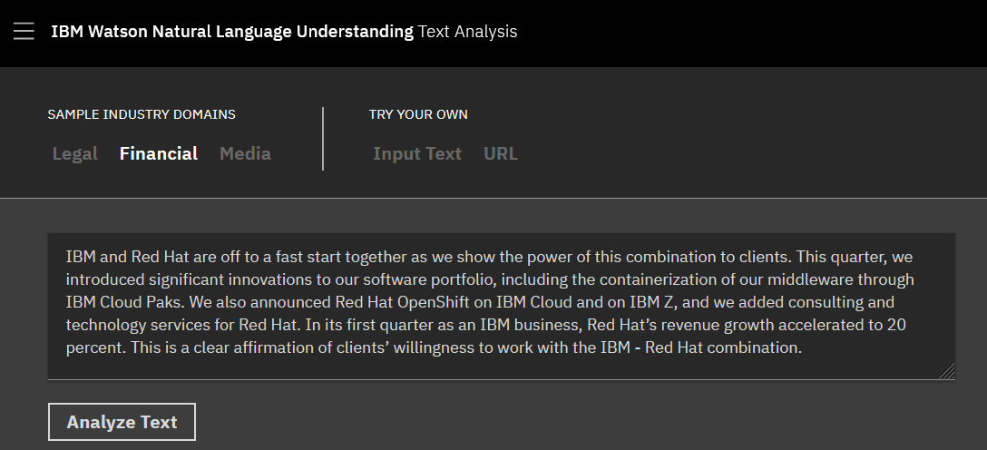
Natural Language Understanding demo
Notes:
The IBM Watson Natural Language Understanding Text Analysis online demo at
https://www.ibm.com/demos/live/natural-language-understanding/self-service/home demonstrates text analytics features that you can use to extract meaning from unstructured data by using the NLU service. In the demo, you can choose from a domain sample to apply the knowledge of unique entities and relations in a particular industry. Alternatively, you can analyze your own text by using the base model. The following slides show this demo with a financial domain sample.
Reference:
IBM Watson Natural Language Understanding Text Analysis
https://www.ibm.com/demos/live/natural-language-understanding/self-service/home

Slide 11
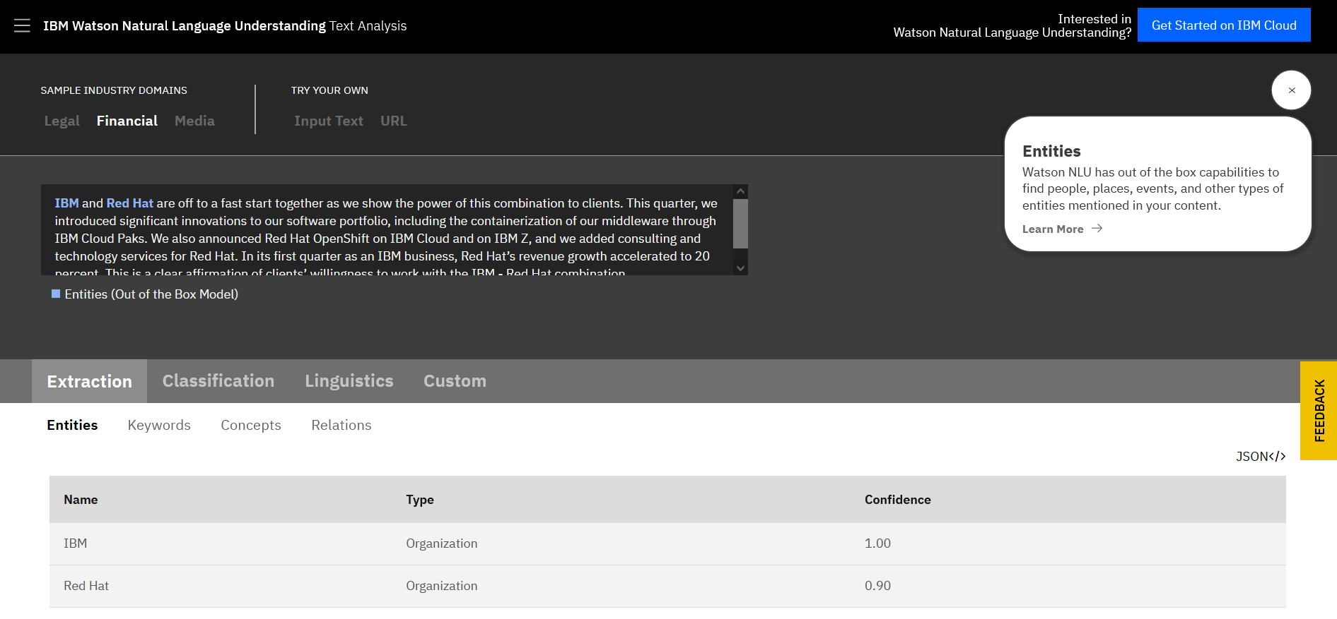
Natural Language Understanding demo – Entities extraction
Notes:
Watson Natural Language Understanding includes out of the box capabilities to find people, places, events, and other types of entities mentioned in your content.

Slide 12
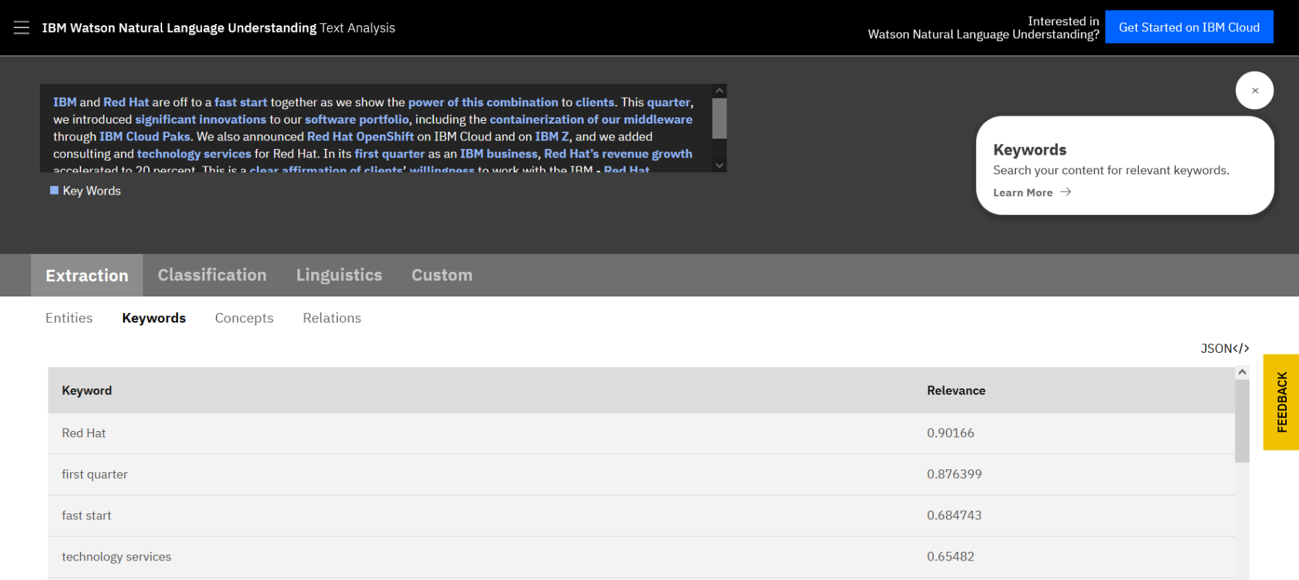
Natural Language Understanding demo – Keywords extraction
Notes:
With Watson Natural Language Understanding, you can extract keywords and search for the relevant ones.

Slide 13
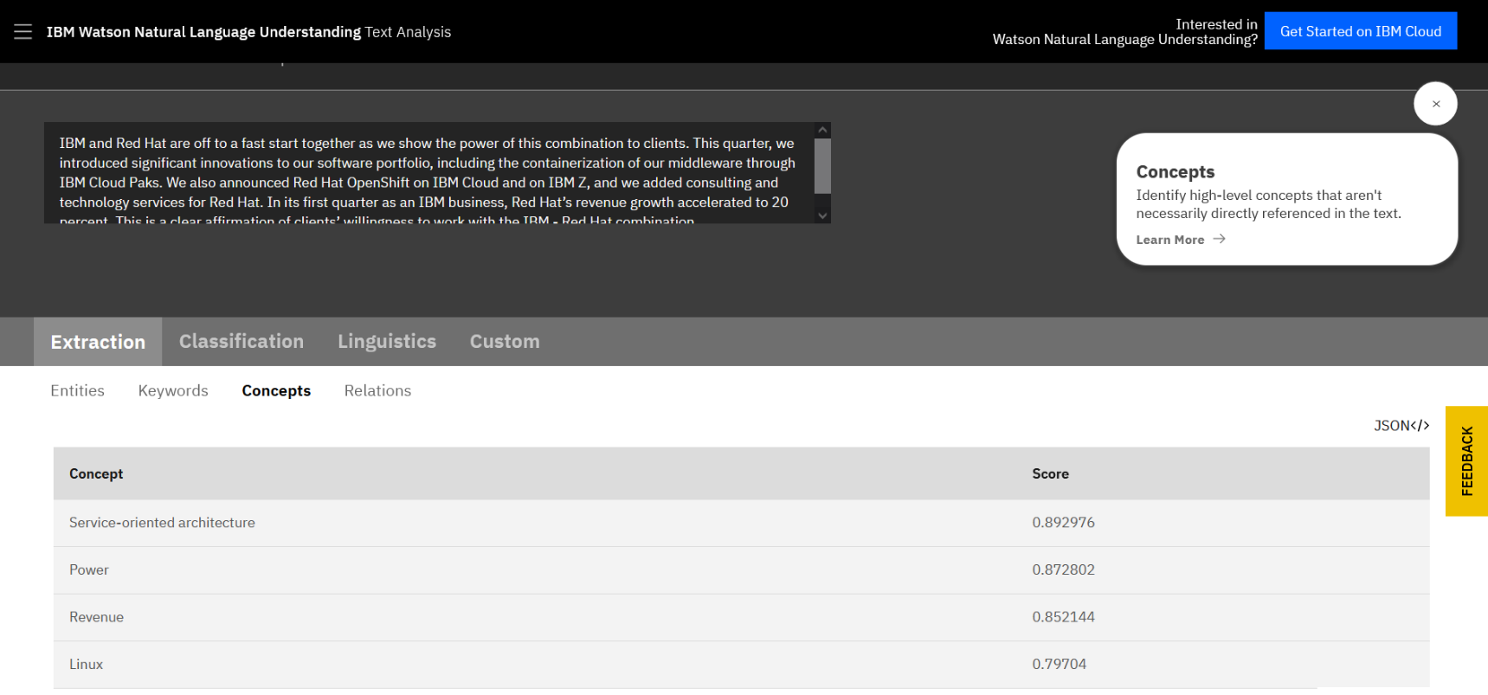
Natural Language Understanding demo – Concepts extraction
Notes:
Natural Language Understanding can identify high-level concepts that are not necessarily directly referenced in the text.

Slide 14
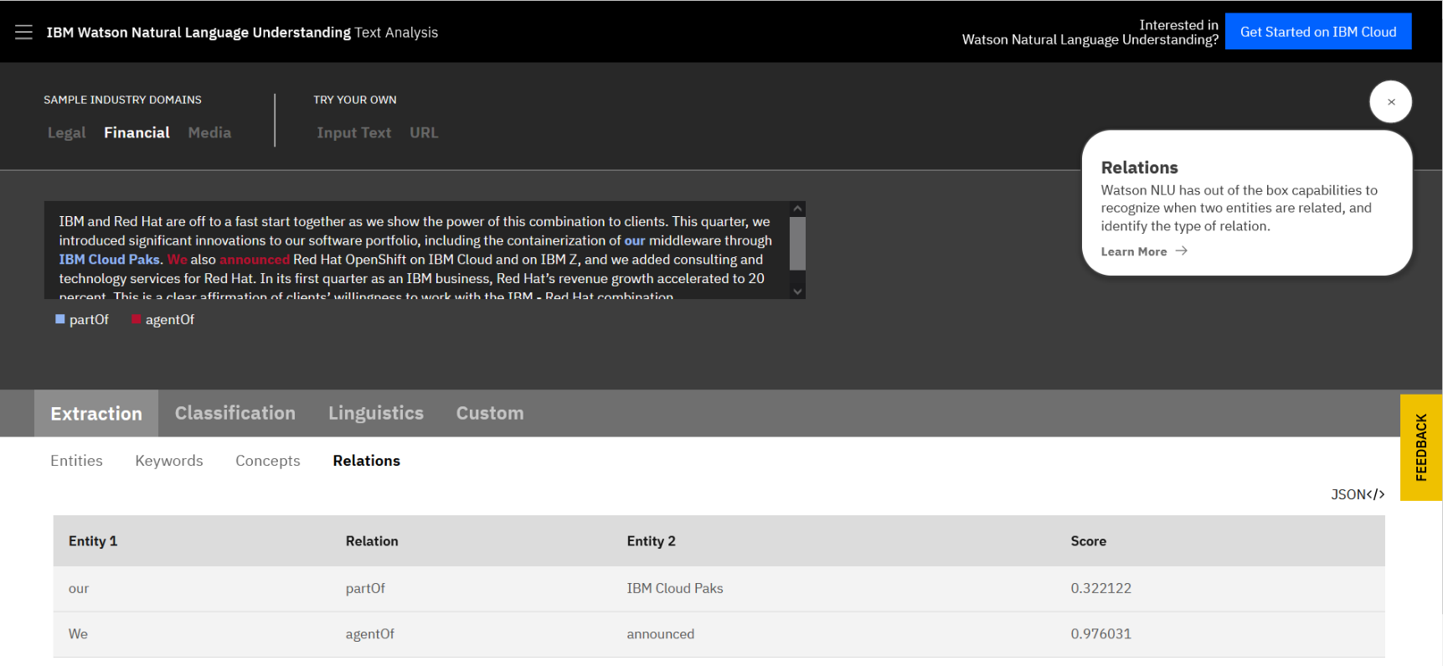
Natural Language Understanding demo – Relations extraction
Notes:
Natural Language Understanding can recognize when two entities are related and identify the type of relation.

Slide 15
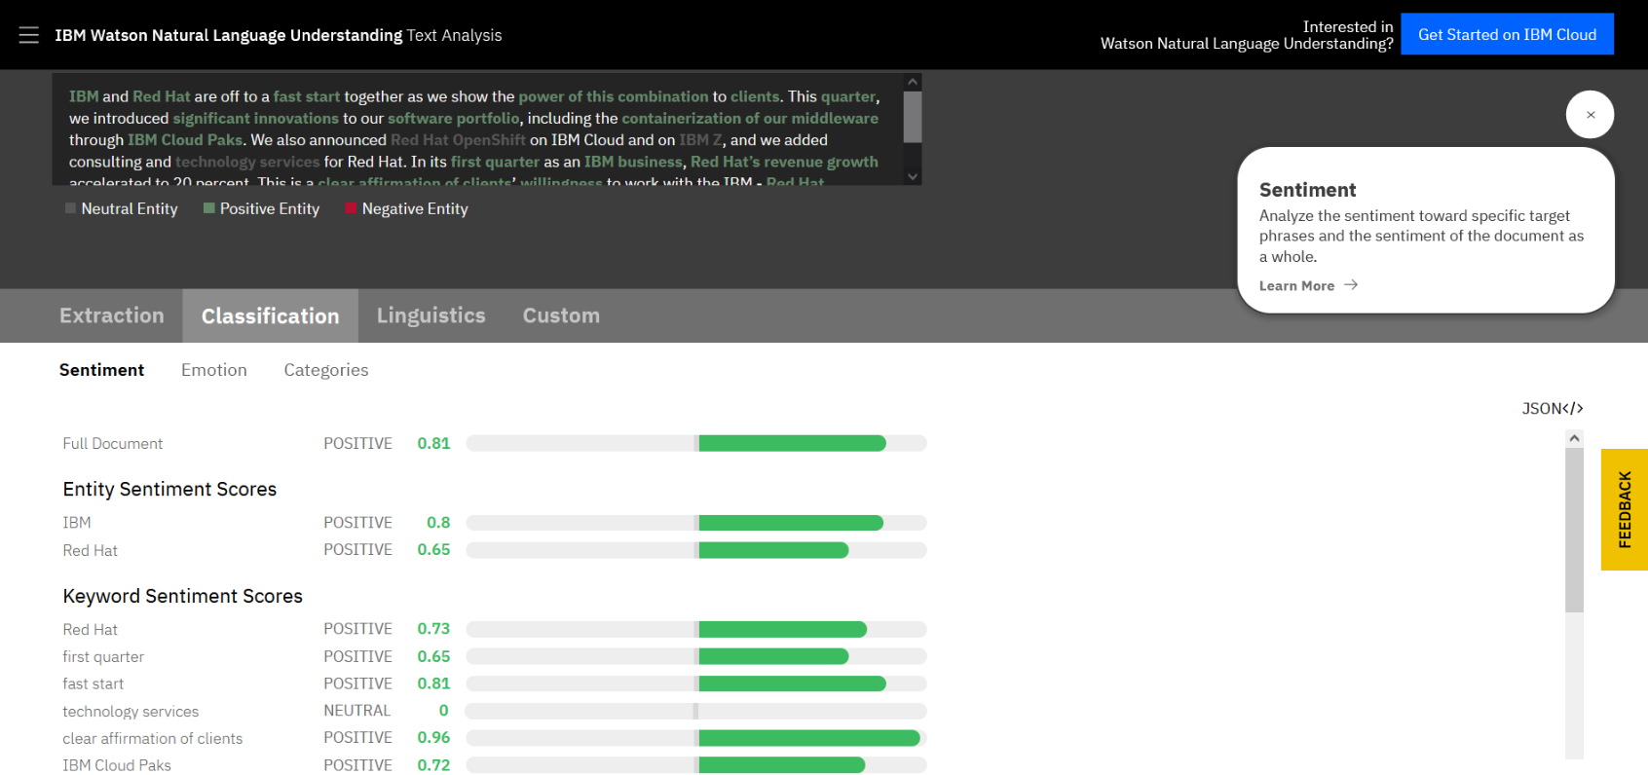
Natural Language Understanding demo – Sentiment analysis
Notes:
Natural Language Understanding can analyze the sentiment toward specific target phrases and the sentiment of the document as a whole.

Slide 16
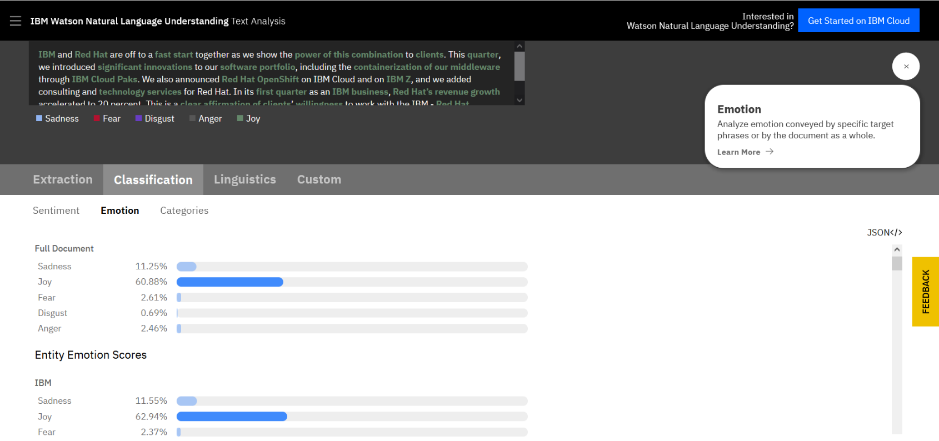
Natural Language Understanding demo – Emotion analysis
Notes:
Natural Language Understanding can analyze emotion that is conveyed by specific target phrases or by the document as a whole.

Slide 17
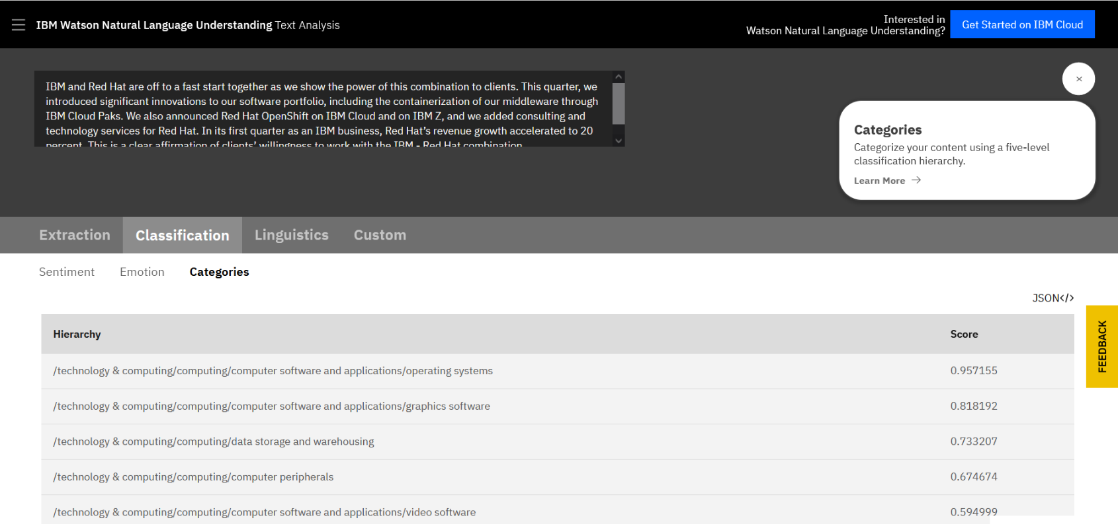
Natural Language Understanding demo – Categories classification
Notes:
Natural Language Understanding can categorize your content by using a five-level classification hierarchy.

Slide 18
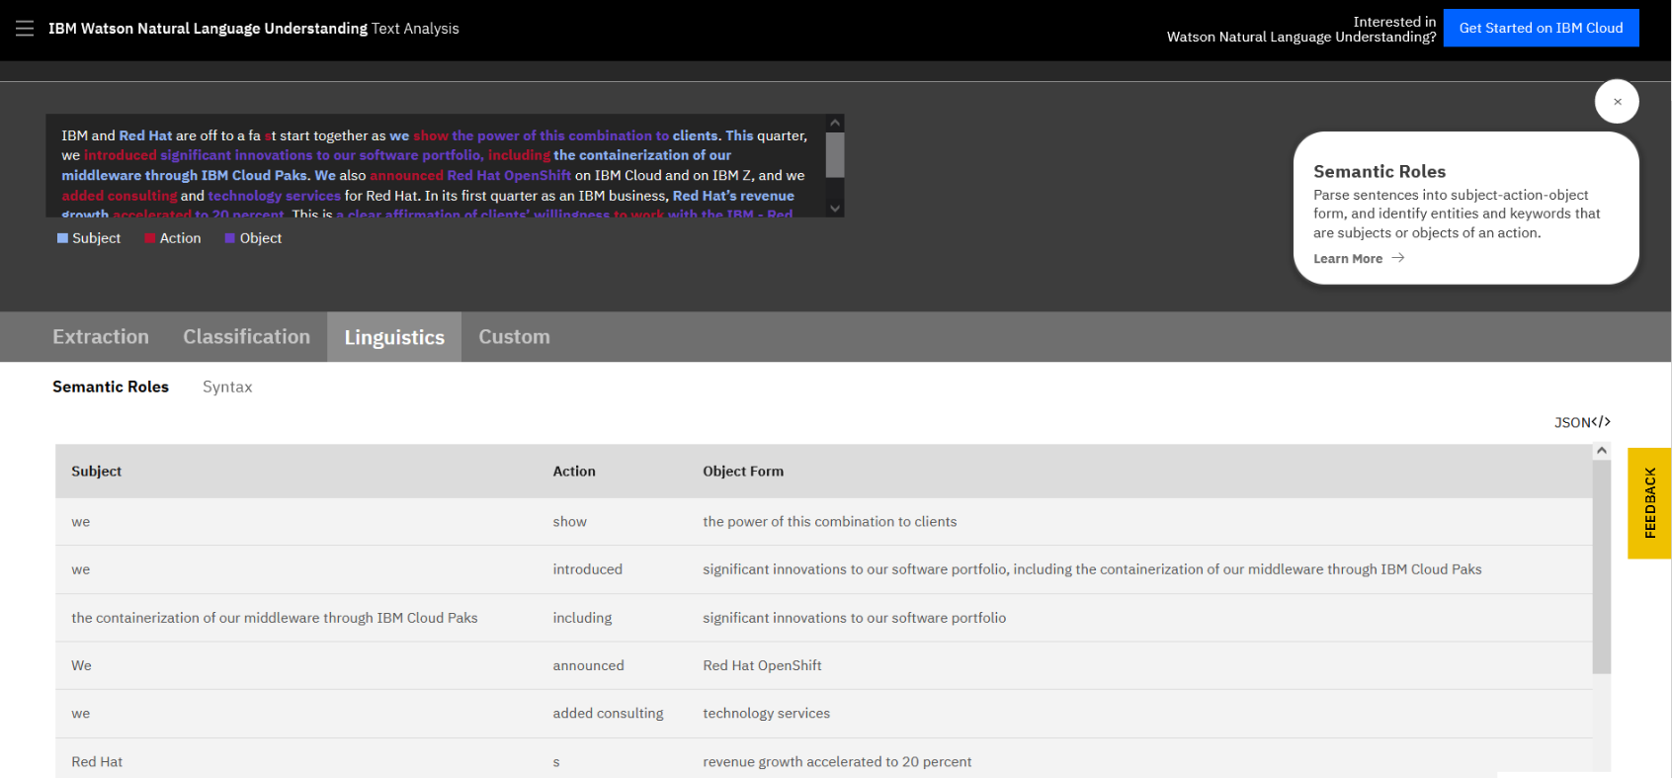
Natural Language Understanding demo – Semantic roles
Notes:
Natural Language Understanding can parse sentences into subject-action-object form and identify entities and keywords that are subjects or objects of an action.

Slide 19
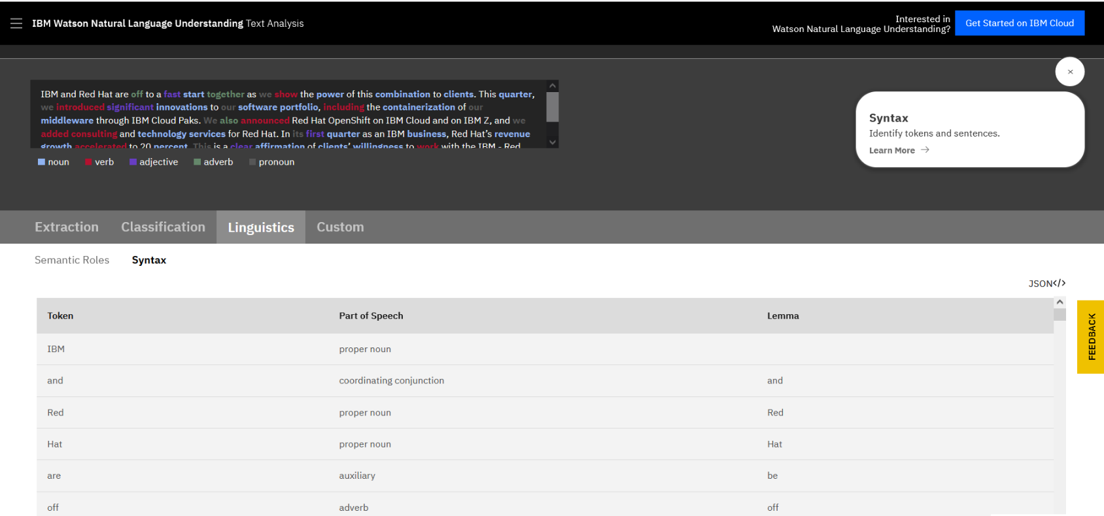
Natural Language Understanding demo – Syntax
Notes:
Natural Language Understanding can identify tokens and sentences.

Slide 20
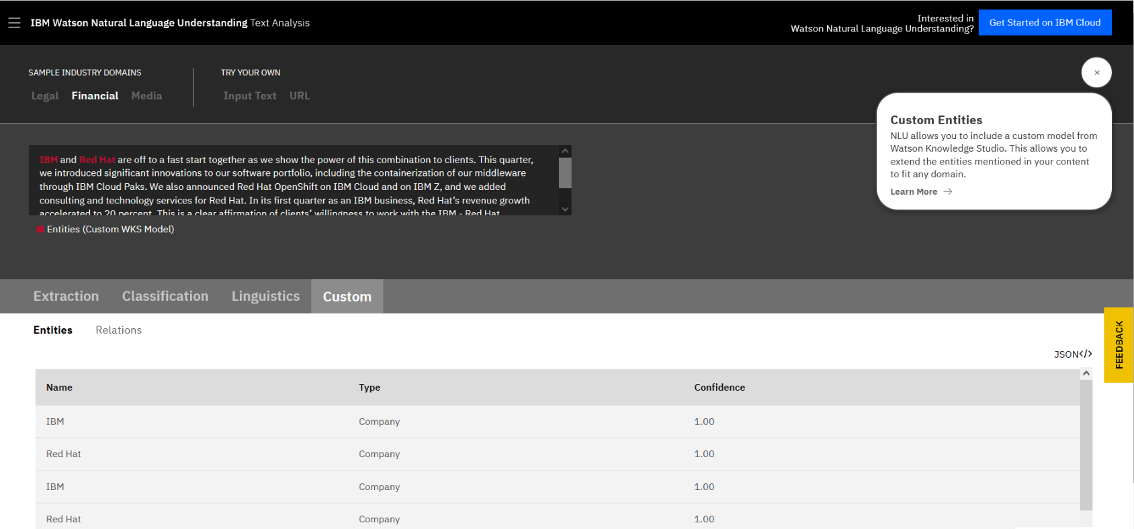
Natural Language Understanding demo – Custom entities
Notes:
Natural Language Understanding allows you to include a custom model from Watson Knowledge Studio so that you can extend the entities that are mentioned in your content to fit any domain.

Slide 21
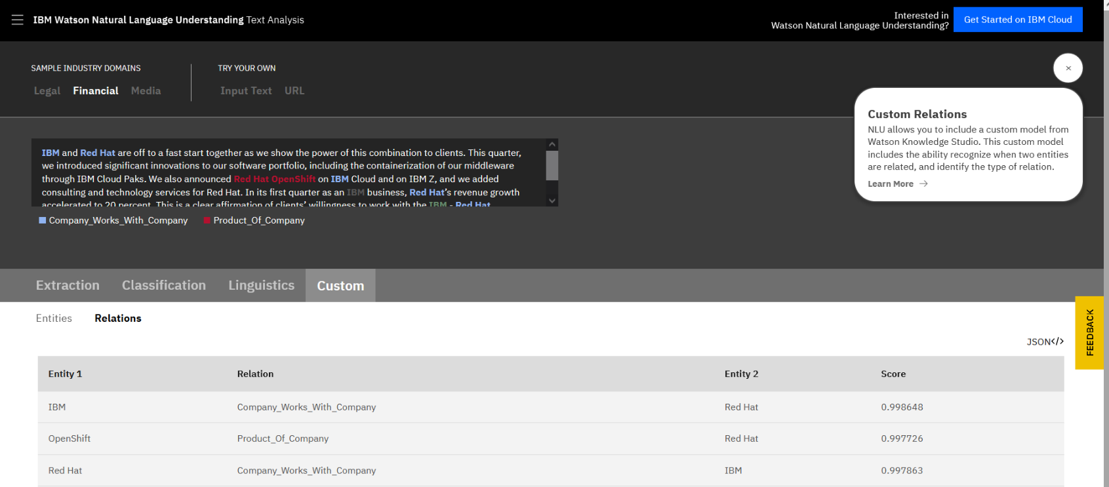
Natural Language Understanding demo – Custom relations
Notes:
Natural Language Understanding allows you to include a custom model from Watson Knowledge Studio. This custom model includes the ability recognize when two entities are related and identify the type of relation.

Slide 22
Watson Discovery

Slide 23
Watson Discovery
Adds cognitive search and content analytics to applications to identify patterns, trends, and insights.
Unlocks actionable insights in unstructured data.
Unifies structured and unstructured data.
Uses simple query language to eliminate the need for manual filtering of results.
Parses documents and enables the user to search through the documents by using a natural language query.
Can be trained.
Includes the Discovery API and Discovery tooling.
Example application: Find answers to FAQs
Notes:
Watson Discovery
With Watson Discovery, you can add a cognitive search and a content analytics engine to applications to identify patterns, trends, and actionable insights that drive better decision-making. You can rapidly build cognitive, cloud-based exploration applications that unlock actionable insights that are hidden in unstructured data.
You can securely unify structured and unstructured data with pre-enriched content and use a simplified query language to eliminate the need for manual filtering of results.
With Discovery, you can prepare your unstructured data, create a query to pinpoint the information you need, and then integrate those insights into your new application or existing solution.
The Watson Discovery services include:
Discovery API. The Discovery service supports various SDKs to simplify the development of applications. The SDKs are available for many popular programming languages and platforms, including Curl, Java, NodeJS, Python, Go, .NET, Ruby, Swift, and Unity.
Discovery tooling. The Discovery service includes a complete set of online tools, the Discovery tooling, to help you quickly set up an instance of the service and populate it with data. The Discovery service tooling was designed to save time by eliminating the need to use APIs to configure and populate your service.
With Discovery, you can build applications that extract the correct answers to FAQs by enriching and searching data collections.
References:
Watson Discovery on Cloud Pak for Data as a Service
https://dataplatform.cloud.ibm.com/docs/content/svc-welcome/watsondisc.html?context=cpdaas&audience=wdp
Discovery API documentation
https://cloud.ibm.com/apidocs/discovery-data?code=unity#introduction

Slide 24
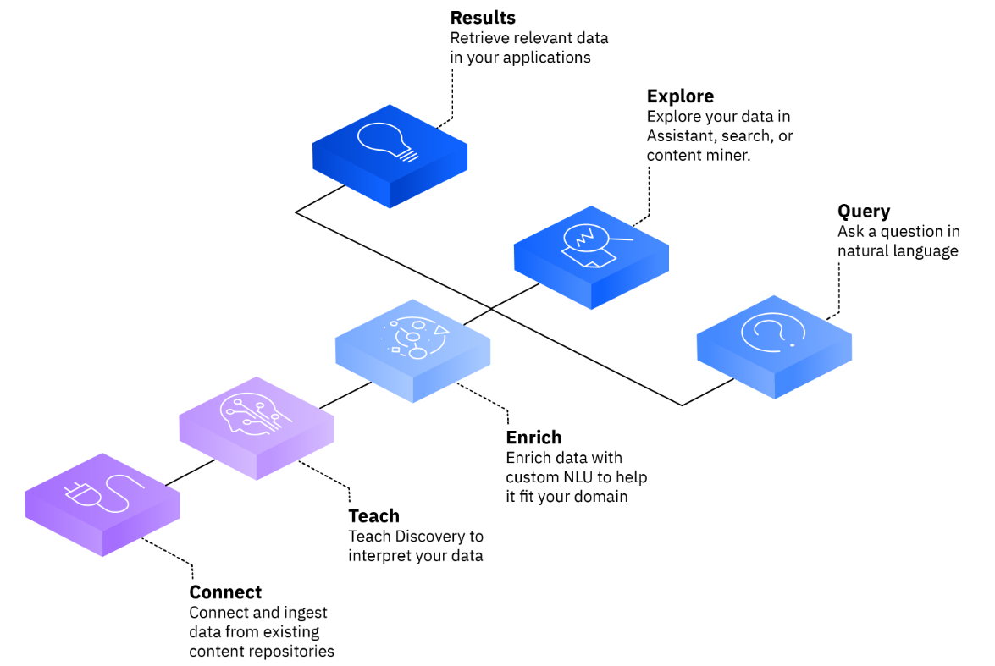
Watson Discovery flow
Discovery provides an end-to-end solution that includes:
Connect your data to Discovery.
Teach Discovery to understand the language and concepts that are unique to your business and industry.
Enrich your data with NLU technologies to identify key information and patterns.
Build search solutions that find answers to queries.
Explore your data to uncover patterns and insights.
Leverage search results in automated workflows.
Notes:
IBM Watson Discovery is an AI-powered search engine that helps you to extract answers from complex business documents.
Use Discovery to visually train AI for deep understanding of your content, including tables and images to help you find business value that is hidden in your enterprise data. Use natural language or structured queries to find relevant answers, surface insights, and build AI-enhanced business processes anywhere.
Start by connecting your data to Discovery. Next, teach Discovery to understand the language and concepts that are unique to your business and industry. Enrich your data with award-winning Natural Language Understanding (NLU) technologies so you can identify key information and patterns. Finally, build search solutions that find answers to queries, explore your data to uncover patterns and insights, and leverage search results in automated workflows.
Supported file types: CSV, DOC, DOCX, GIF, HTML, JPG, JSON, PDF, PNG, PPT, PPTX, TIFF, TXT, XLS, XLSX
References:
About Watson Discovery
https://cloud.ibm.com/docs/discovery-data?topic=discovery-data-about
Supported file types
https://cloud.ibm.com/docs/discovery-data?topic=discovery-data-collections#supportedfiletypes

Slide 25
Unit summary
List the NLP Watson services.
List the Watson services that perform information extraction.
Describe the capabilities of the IBM Watson Natural Language Understanding.
Describe the capabilities of IBM Watson Discovery.

Slide 26

Review questions
True or False: Watson Natural Language Understanding parses documents and enables the user to search through the documents by using a natural language query.
True or False: You can teach Discovery to understand the language and concepts that are unique to your business and industry.
Watson Discovery provides one of the following capabilities:
Returns best matching image.
Identifies a variety of tones at both the sentence and document level.
Adds cognitive search and content analytics to applications to identify patterns, trends, and insights.

Slide 27
Review questions (cont.)
True or False: The NLU Semantic Role feature parses sentences into subject-action-object form and identifies entities and keywords that are subjects or objects of an action.
Knowledge Studio can be used to extend NLU with custom models to detect ________ in your domain.
Sentiment and emotions
Entities and relations
Syntax and sentences
None of the above

Slide 28

Review answers
True or False: Watson Natural Language Understanding parses documents and enables the user to search through the documents by using a natural language query.
True or False: You can teach Discovery to understand the language and concepts that are unique to your business and industry .
Watson Discovery provides one of the following capabilities:
Returns best matching image.
Identifies a variety of tones at both the sentence and document level.
Adds cognitive search and content analytics to applications to identify patterns, trends, and insights.

Slide 29
Review answers (cont.)
True or False: The NLU Semantic Role feature parses sentences into subject-action-object form and identifies entities and keywords that are subjects or objects of an action.
Knowledge Studio can be used to extend NLU with custom models to detect ________ in your domain.
Sentiment and emotions
Entities and relations
Syntax and sentences
None of the above

Slide 30
Exercise: Ingesting, converting, enriching, and querying data with the IBM Watson Discovery service

Slide 31
Exercise objectives
With Watson Discovery, it takes only a few steps to prepare your unstructured data, create a query that pinpoints the information that you need, and then integrates those insights into your new application or existing solution.This exercise takes you through the process of preparing and querying a collection of documents.
After completing this exercise, you should be able to:
Create a Watson Discovery service instance.
Create a collection.
Add content to a collection.
Create a custom configuration.
Build queries.
Use the Watson Discovery API.
Notes:
After completing this exercise, you should be able to:
Create a Watson Discovery service instance.
Create a collection.
Add content to a collection.
Create a custom configuration.
Build queries.
Use the Watson Discovery API.

